Slide 1
A Presentation on Performance Testing with Load Runner
By Dheeraj Sharma

Slide 2
Performance Testing
Performance Testing is a type of Non-functional Software testing, in which we test the Stability and Response time(Speed) of an application by applying the Workload.
Workload
Performance Testing = Stability + Response

Slide 3
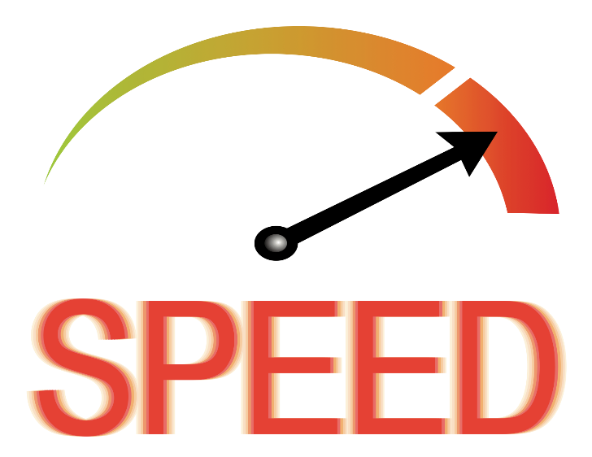


Why Performance Testing?
Speed
Scalability
Stability

Slide 4
Performance Testing Process Flow
1. Requirement Gathering
2. Analysis & Identify the Scenarios
3. Test Environment Set up
4. Test Data Analysis
5. Test Script Development
6. Test Script Replay & Enhancement
7. Test Execution
8. Test Execution Result Collection & Analysis
9. Performance Testing Reporting

Slide 5
Type of Performance Testing
Baseline Test
Load Test
Stress Test
Soak Test
Volume Test
Failover Test

Slide 6
Baseline Testing
Baseline Testing is the process of identifying the ‘behavior’ of a system with a single user.

Slide 7
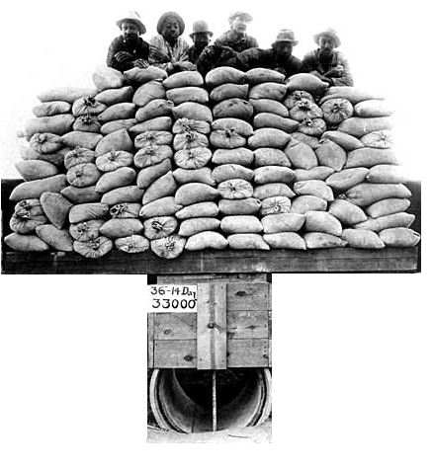
Load Testing
Load Testing is the process of identifying the ‘behavior’ of a System under a given load.
For conducting Load Testing the ‘behavior’ of the
system can be measured over specific parameters
called system counters.
Example : Response Time of ‘Logon’ for multiple
Load are given here
User Load | Response Time(Sec)
50 | 3
100 | 5

Slide 8
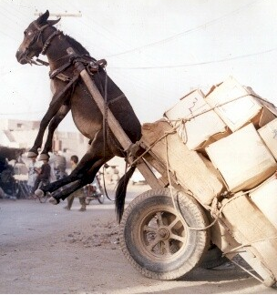
Stress Testing
Stress Testing is the process to identify the point of Load where system crashes.
Load is put on the system in ever increasing manner until system crashes.

Slide 9
Soak Testing
Soak testing also known as Endurance Testing.
Soak testing involves testing a system with a significant load extended over a significant period of time, to discover how the system behaves under sustained use.
Example :-is where the user stays logged into a system for many hours executing a number of business transactions.

Slide 10
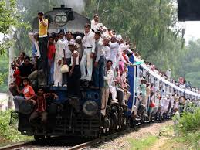
Volume Testing
Testing where the system is subjected to large volumes of data.

Slide 11
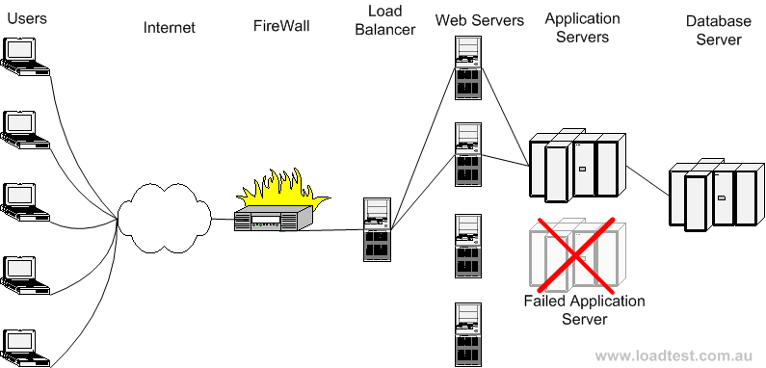
Failover Testing
Failover Testing is the process to identify the System behavior when one or many of its components are failed.

Slide 12
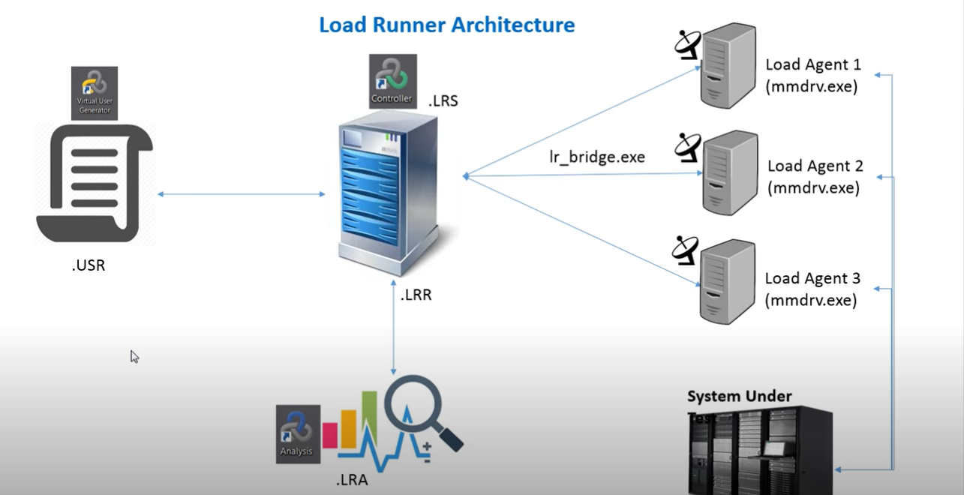
Load Runner Architecture

Slide 13
Performance Test Engineering Concepts
Virtual Users(VUsers) - Simulated users used to put load on the servers.
Think Time :
Time taken by the User to Enter the Details While performing the Transaction.

Slide 14
Performance Test Engineering Concepts
Transactions Per Hour – TPH:
Each Transaction is a Single User Action which Updates the Database.
Pacing Time
Pacing is the time between the script iterations which is used to achieve the required TPH.

Slide 15
Performance Test Engineering Concepts
Concurrent Execution
More than one users are executing at the same point of time, but with different flows.
Simultaneous Execution
More than one users are executing the same flow at the same point of time.

Slide 16
Performance Test Engineering Concepts
Ramp-up
Ramp up decides the rate at which virtual users add to the load test.
Example:- Ramp-up rate – 5 Vusers per 10 seconds
Ramp down
Ramp down decides the rate at which virtual users exit from the load test.
Example:- Ramp-down rate – 20 Vusers per 5 seconds

Slide 17
Parameterization
Parameterization technique is used to pass the different static values in the script at different instances during execution.
Which ever the values entered through keyboard those values should be parameterized.

Slide 18
Types of Parameters
Date/Time
File
Iteration Number
Random Number
Table
Unique Number
Custom
XML

Slide 19
Correlation
The way to handling dynamic values which are generated by server in client server communication.
The values captured will be send back to server in later steps in the script.

Slide 20
Types of Correlation
Auto Correlation
Automatically handling Dynamic Values.
Manual Correlation
Manually we have to handle the dynamic values by LoadRunner correlation Functions.
Example: -
Web_reg_save_param
Web_reg_save_param_regexp

Slide 21


